Slide 1
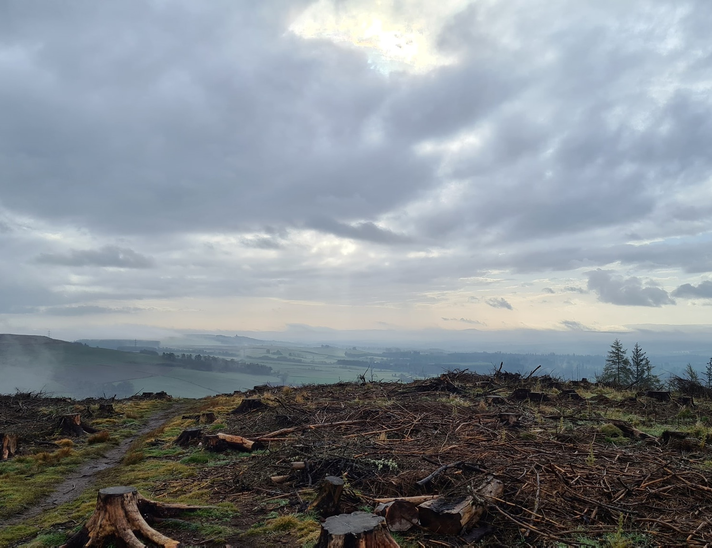
Start your datacentre transformation journey with Azure Migrate
Sarah Lean Senior Cloud Advocate @Techielass www.techielass.com

Slide 2
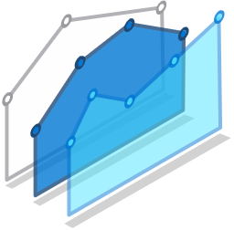

Migration Triggers
Cybersecurity threats
Cost efficiency & resource constraints
Fragile on-premises operations
Why are customers migrating?
Supporting remote work models
Meeting surge demand

Slide 3
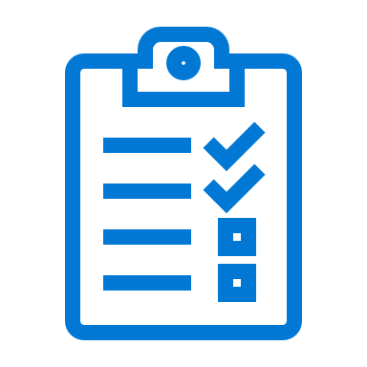
Migration stages
Discovery
Assessment
Migrate
Manage
Foundational best practices: People | Process & Planning | Technology

Slide 4
Walk through the STAGES of a migration project

Slide 5
Walk through the STAGES of a migration project
Explore how AZURE MIGRATE can assist with your migration

Slide 6
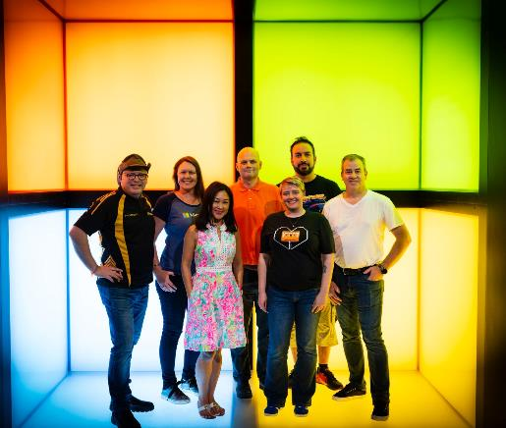


Who am I?
Senior Cloud Advocate @ Microsoft
Blog at www.techielass.com
@Techielass
Founder of the Glasgow Azure User Group
STEM Ambassador
14+ years in the IT industry
IT Pro

Slide 7

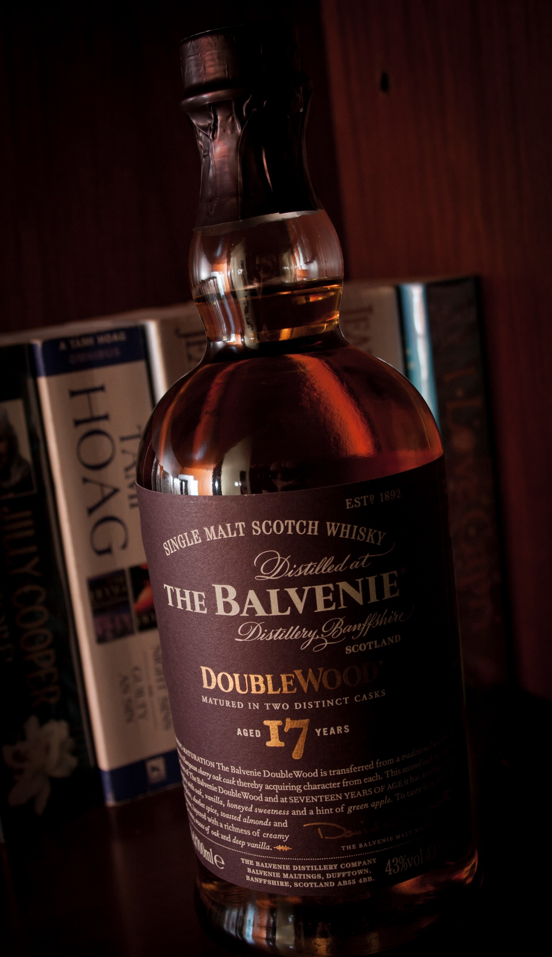
Scotland is the home of…

Slide 8
Discovery Stage
Microsoft Azure | @Techielass

Slide 9

Understand your environment
Microsoft Azure | @Techielass

Slide 10

Staff Training
Microsoft Azure | @Techielass

Slide 11

Tooling
Microsoft Azure | @Techielass

Slide 12
Azure Migrate timeline
Sept 2017 – Azure Migrate announced
Feb 2018 – Goes GA!
July 2019 – Version 2 Launched
August 2018 – New price modelling functionality launched
Jan 2019 – new region support launched
Nov 2019 – Agentless functionality previewed
June 2020 - Assessments for on-premises VMware VMs to Azure VMware Solution
Sept 2020 – Availability Zones support
March 2021 – Azure Migrate appliance now supports multiple server credentials
May 2021 – Migration of OS disks up to 4TB now supported

Slide 13




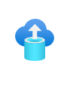



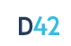



Choice of tools for every stage and every requirement
Servers
Databases
Web apps
VDI
Data
Azure Migrate:
Server Assessment
Azure Migrate:
Database Assessment (DMA)
Azure Migrate: Web App Assessment
Lakeside: SysTrack
Azure Databox
(Third Party Tool)
Azure Migrate:
Server Migration
Azure Migrate: Database Migration (DMS)
Azure Migrate: Web App Migration
Azure Migrate:
Server Migration
Movere
Partner tools
Cloudamize
Turbonomic
UnifyCloud
Device42
RackWare
Microsoft Azure | @Techielass

Slide 14
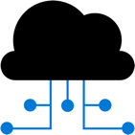
Discover: Capabilities
Any platform
VMware, Hyper-V, physical servers, AWS, GCP
CMDB, CSV imports
Agentless discovery
For all hypervisors, bare-metal servers and servers on other clouds
Inventory applications
And roles enabled on servers (only for VMware)
Visualize dependencies
Across application layers or across servers (agentless for VMware)
Microsoft Azure | @Techielass

Slide 15
Azure Migrate appliance
Unified appliance
For server discovery, assessment and migration.
For VMware: discovery, assessment and migration
For Hyper-V: discovery and assessment
For physical and other clouds: discovery and assessment
Dedicated machine
Installed in source environment
Runs Azure Migrate software to connect to vCenter/Hyper-V host/physical servers/virtual machines to perform discovery
Deployment options
Virtual appliance that can be imported – OVA option for VMware, VHD option for Hyper-V
Installer option on dedicated Windows Server 2016 for all scenarios
Deploy as VM or physical machine
No impact to source
Appliance does not install any software on source VMs or hosts
Microsoft Azure | @Techielass

Slide 16




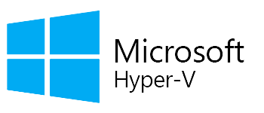


Discovery: Process
For all scenarios
Deploy and configure the Azure Migrate appliance in the source environment
Appliance discovers servers and server configurations, and collects performance data (resource utilizations) for Windows and Linux servers
View discovered servers
Microsoft Azure | @Techielass

Slide 17

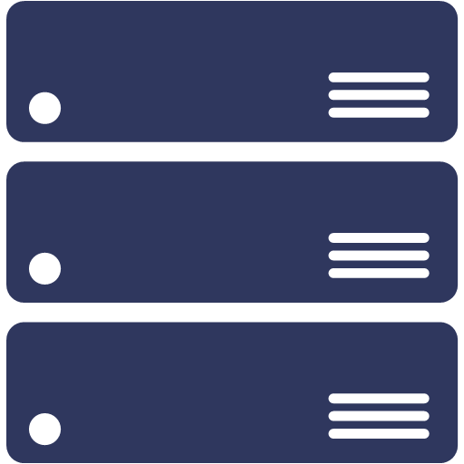



Discovery: Supported versions & pre-requisites
VMware
Hyper-V
Physical/other cloud
Host requirements
ESXi hosts version (5.5 or later)
Host requirements
Windows Server 2012 R2 or later
PowerShell remoting
Administrator permissions
For Windows servers
Local or domain joined account
vCenter requirements
vCenter Server version (5.5, 6, 6.5, 6.7, 7)
Read-only account
For Linux servers
An account with root permissions
Supported VMs
All operating systems
Disks attached to SCSI, IDE, SATA controllers
Supported VMs
All operating systems
Hyper-V Integration Services enabled
Supported VMs
All operating systems
Microsoft Azure | @Techielass

Slide 18
Discovery: Data management
For all scenarios
 | Configuration data | Performance data
Polling interval | Collected every 30 mins Differential sent to Azure every 30 mins | Collected every 20 secs. (VMware); 30 secs (Hyper-V); 5 mins. (physical servers) Aggregated every 10 mins. based on peak value Peak points transmitted to Azure
Secure Hashing Algorithm | SHA 256 (in transit and at rest) | SHA 256 (in transit and at rest)
Datastore | Azure Cosmos DB in Microsoft subscription | Azure Data Explorer in Microsoft subscription
Retention | 3 days post VM removal from discovery Migrate project deletion | Auto-deletion after 30 days; sooner if Azure Migrate project is deleted
Storage region | Any region within Migrate project geography | Any region within Migrate project geography
Appliance component used | Discovery agent | Collector agent
Microsoft Azure | @Techielass

Slide 19
Discovery: Resource Limits
Azure Migrate project
35000 servers (individually for each scenario) Same project can be used for multiple scenarios
Per Azure Migrate appliance
VMware
1 vCenter server 10000 servers 400 servers (dependency analysis)
*Discovery scoping supported
Hyper-V
300 hosts 5000 VMs
Physical/other cloud
1000 physical servers
Microsoft Azure | @Techielass

Slide 20
Assessment: Confidence rating computation or performance-based
For performance-based
Computation formula:
Output is categorized as:
0 to 20% data points
Confidence rating
Actual data point received
100 pts
x
20 to 40% data points
Expected data points
40 to 60% data points
Duration of assessments in mins
60 to 80% data points
Expected data points
10 mins
80 to 100% data points
Low confidence ratings indicate fewer data points availability. Could be due to:
Shorter profiling period (performance history duration > actual period for which data was available)
On-prem VMs shutdown
Appliance unable to load perf data
Temporary appliance shutdown
Microsoft Azure | @Techielass

Slide 21
Assessment Stage
Microsoft Azure | @Techielass

Slide 22

Success
Microsoft Azure | @Techielass

Slide 23


Decisions
Microsoft Azure | @Techielass

Slide 24

Timing
Microsoft Azure | @Techielass

Slide 25
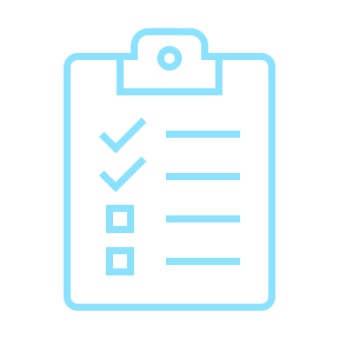


Management
Microsoft Azure | @Techielass

Slide 26



Meetings
Microsoft Azure | @Techielass

Slide 27

Migrate Stage
Microsoft Azure | @Techielass

Slide 28




Migration: Capabilities
Multiple options
Agentless migrations for VMware and Hyper-V virtual machines
Agent-based for other scenarios
Migrate at scale
Supports migrating 100s of servers simultaneously and automation options to execute at scale
Test before migrating
Perform testing cycles before migrating without impacting source server and ongoing replication
Zero data loss
And minimal downtime during migration
Microsoft Azure | @Techielass
Microsoft Azure | @Techielass
Microsoft Azure | @Techielass

Slide 29
Migration: Overview
Azure Migrate: Server migration vs Azure Site Recovery
 | Azure Migrate: Server migration | Azure Site Recovery
Scenario | Purpose-built for server migration to Azure | Built for disaster recovery (DR) for servers
Options | Agentless for VMware & Hyper-V Agent-based | Agent-based (migrating with DR constructs)
Pricing | Free tooling (migrate within 180 days per machine) Pay for only storage and network Compute charges for test migration | Free tooling for 31 days (charges per server instance)
Feature support | Integrated end-to-end journey tracking Carry forward assessments for migration Migration centric features (custom resource naming, tagging, automatic Azure VM agent install etc.) | Disaster recovery-centric features
Recommended use | Migration to Azure | Disaster recovery of Azure VMs and for hybrid disaster recovery scenarios
Pricing | Free | Free for first 180 days
Both tools share certain components. Recovery Services vault is used by Azure Migrate: Server Migration, Disaster Recovery, and Azure Backup.
Common components are used for replication in the Hyper-V and agent-based replication scenarios.
Microsoft Azure | @Techielass
Microsoft Azure | @Techielass

Slide 30
Migration: Scenarios
Agentless VMware
Agentless Hyper-V
Physical/other cloud
Requirements
Uses the Azure Migrate appliance
No software on VMs
Requirements
Uses Hyper-V Replication Provider installed on hosts
No software on VMs
Requirements
Uses replication appliance (configuration & process server) installed on dedicated machine
Uses mobility service installed on servers
Scale
300 concurrent replications
Scale
Limited by space available on Hyper-V hosts
Scale
Scale out with additional Process server
*This method can also be used to migrate VMware or Hyper-V servers by treating them as physical servers
Microsoft Azure | @Techielass

Slide 31
Agent-based: Process
Deploy Replication appliance (also known as configuration server) in your source environment
Install Mobility Service on the servers to be migrated
Start replicating your Windows and Linux servers using Azure Migrate: Server Migration
Replication appliance orchestrates the replication of your VM data to your Azure subscription
Perform test migrations to a sandbox environment with no impact to production to validate migration
Migrate with minimal downtime
For physical servers/AWS, GCP, other cloud servers
Sandbox environment
Deploy Hyper-V Replication Provider on Hyper-V host
Start replicating your Windows and Linux servers using Azure Migrate: Server Migration
The Hyper-V Replication Provider orchestrates the replication of your VM data to your Azure subscription
Perform test migrations to a sandbox environment with no impact to production to validate migration
Migrate to Azure with zero data-loss and minimal downtime
Microsoft Azure | @Techielass

Slide 32
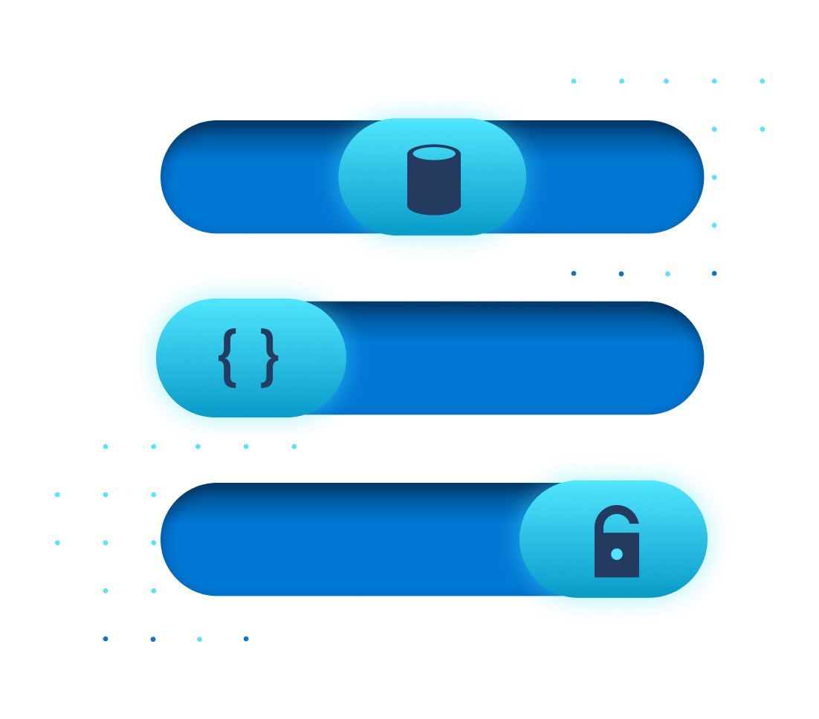
Migration: Test Migration
How do I demarcate a sandbox environment?
By specifying a Virtual Network while starting test migration
Subnet is automatically selected in following priority -
Subnet with same name as the target subnet specified while enabling replication
First subnet available alphabetically that is not a gateway/application gateway/firewall/bastion subnet
What is it?
Creates test copies of replicating servers in an Azure sandbox environment
Intended to help validate server and app functionality
Non-disruptive to source server and ongoing replication
Can be performed multiple times once Initial Replication is completed
Microsoft Azure | @Techielass

Slide 33
Migration: Bandwidth Consumption
To what does this asterisk refer?
For agentless migrations
For agent-based migrations
Estimate time needed or bandwidth required based on volume of data
Time to complete initial replication = {size of disks (or used size if available) * 0.7 (assuming a 30 percent compression average)}/bandwidth available for replication
For VMs on the same ESXi host:
Use Azure Site Recovery Deployment planner tool. Outputs from the tool include:
Estimated network bandwidth required
Projected throughput for replication
Concurrent replications that can be enabled (for specified time period to complete migration)
Disks to be used for Azure VMs (standard, premium)
Microsoft Azure | @Techielass

Slide 34
Migration: Replication Bandwidth Throttling
For agentless VMware migrations
For agentless Hyper-V migrations
For agent-based migrations
Set the NetQoSPolicy with throttle rate on Azure Migrate appliance
On the Hyper-V host
To control upload bandwidth, use the Windows Azure Backup MMC snap-in and configure maximum bandwidth to use
To increase upload efficacy, increase the number of threads used for data upload
On the replication appliance (configuration server) and/or scale-out process servers
To control upload throughput, use the Windows Azure Backup MMC snap-in and configure maximum bandwidth to use
To increase upload efficacy, increase the number of threads used for data upload
Microsoft Azure | @Techielass

Slide 35



Migration: Using ExpressRoute
On-premise environment
Replication appliance
(agent-based)
Hyper-V Replication Provider
Azure Migrate appliance - VMware
Replication data can be routed through ExpressRoute with Microsoft Peering
Control plane (replication orchestration) communications happen over the Internet
To configure Microsoft Peering for replication data transfer, advertise routes for following BGP communities –
Regional BGP community for the source Azure region (Azure Migrate Project region)
Regional BGP community for the target Azure region (region for migration)
BGP community for Azure Active Directory (12076:5060)
If using proxy setup on-premise, then configure proxy bypass for “.*.blob.core.windows.net”
Partner Edge
ExpressRoute circuit
Azure Edge
Azure Migrate
Azure Storage
Azure Compute
Orchestration data (over Internet)
Replication data (over ExpressRoute with Microsoft Peering)
Connectivity to Azure VM post failover (over ExpressRoute with Private Peering)
Microsoft Azure | @Techielass

Slide 36

Manage
Microsoft Azure | @Techielass

Slide 37
Training
Microsoft Azure | @Techielass

Slide 38

Documentation
Microsoft Azure | @Techielass

Slide 39

Cost Management
Microsoft Azure | @Techielass

Slide 40

Maturity
Microsoft Azure | @Techielass

Slide 41






Key Learnings
What does success look like?
Involve the Business at every step
Script and Automate where you can
Choose the right tools for the job
Track and optimize spend

Slide 42



Thank you!
https://aka.ms/cloudcamp-resources
Sarah Lean
Senior Cloud Advocate
@Techielass
www.techielass.com

